Slide 1
ADC Interfacing-8051

Slide 2
Analog to Digital Converter(ADC)
-ADC is a device which convert analog voltage to digital numbers so that microcontroller can handle and processes the data.
Terms:
RESOLUTION:
Resolution refers to the number of discrete values that an ADC can produce over the range of analog values.
The values are usually stored electronically in binary form, so the resolution is usually expressed in bits.
We can say that ADC has n bit resolution where n can be 8,10,12,16 and 24 bits.

Slide 3
STEP SIZE:
It is the voltage difference between one digital level and the next level that can be measured by ADC.
In a 4-bit converter, an input of 1 Volt produce an output of 0001, then the step size is 1 Volt. 0 volts is always considered 0000.
Distortion in the signal can be reduced by decreasing the step size to 0.5 volts but it lowers the maximum input reading.
If we are using smaller step size, higher bit converter is needed to have maximum voltage.

Slide 4
ADC 0804:
ADC0804 is a single channel analog to digital convertor i.e it takes only one analog signal.
It has 8 bit resolution.
    Other ADC can have n bit resolution and n can be 8,10,12,16 or 24 bits.
If ADC has higher resolution, it gives smaller step size.
If ADC has 8 bit resolution, input voltage span is 0-5V and the step size is 19.53mV (5V/255).
Built-in clock generator

Slide 5
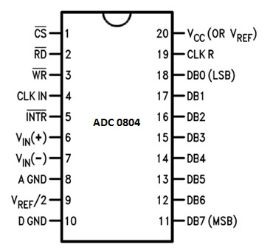
Pin diagram of ADC

Slide 6
CS: (Chip Select)
It is an active low pin and is used to activate ADC0804
RD:
It is an input pin and is active low.
ADC stores the result in an internal register after conversion of analog data.
This pin helps to get the data out of the ADC0804.
When CS=0, high to low pulse is given to RD pin, then digital output comes on the pins D0-D7
WR:
It is an input pin and is active low which is used to initiate the ADC to start the conversion process.
When CS=0, WR makes a low to high transition, then ADC starts the conversion process.
CLK IN:
This is an input pin which is connected to an external clock source.

Slide 7
INTR:
This is an output pin and is active low.
When the conversion is over, this pin goes low.
Vin+: Analog Input
Analog input to ADC.
Vin-: Analog Input.
Analog input connected to ground.
AGND: Analog Ground
Connected to ground.
Vref/2: Reference Voltage
Used to set the reference voltage. Default reference voltage is 5V when not connected. Step size can be reduced by using this pin.

Slide 8
DGND: Digital Ground
Connected to ground.
D7-D0: Output Data Bits
Output bits of binary data.
CLKR: Clock Reset
To reset the clock.
Vcc: Positive Supply
Power supply of ADC.

Slide 9
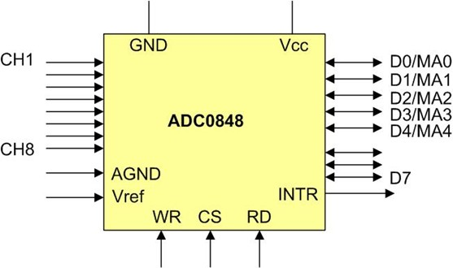
Parallel ADC Block Diagram

Slide 10
Steps for converting the analogue input and reading the output from ADC0804.
Make CS=0 and send a low to high pulse to WR pin to start the conversion.
Now keep checking the INTR pin. INTR will be 1 if conversion is not finished and INTR will be 0 if conversion is finished.
If conversion is not finished (INTR=1) , poll until it is finished.
If conversion is finished (INTR=0), go to the next step.
Make CS=0 and send a high to low pulse to RD pin to read the data from the ADC.

Slide 11
